Slide 1
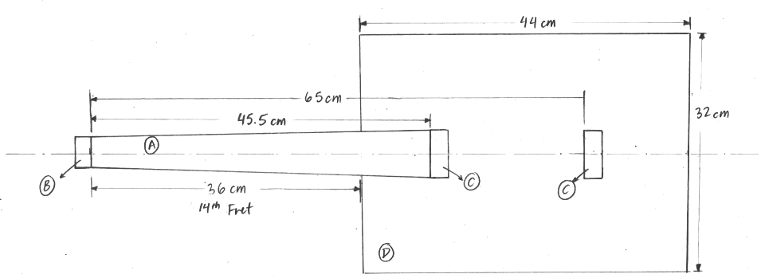
Guitar Strings
Strain Gauge Sensors
Screw Eyes
Arduino

